Slide 1
Full Text Search
Trương Công Thái
Hồ Huy Cường
Nguyễn Lê Hoàng Thiện

Slide 2
What is Full Text Search???
Searching base on index, isn’t a part of SQL Server.
Belong to Microsoft Index Server and Site Server
Is a mechanism of MS SQL Server that allow us search a word, a phrase, or a whole document file/ image in the fastest and the most efficient way.

Slide 3
What is Full Text Search???
Support multi-language (up to 48 languages, including Vietnamese)
Support multi-type of character data (char, varchar, nvarchar) or binary data (varbinary, image)

Slide 4
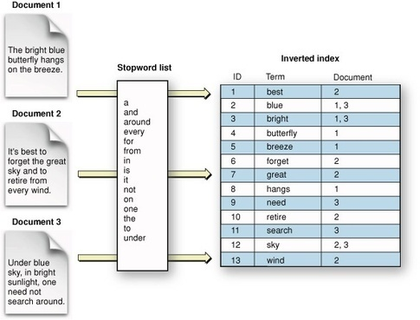
Full Text Index

Slide 5
Full-Text Catalog
A full-text catalog provides a mechanism for organizing full-text indexes. Each catalog can contain zero or more indexes, but each index can be associated with only one catalog.

Slide 6
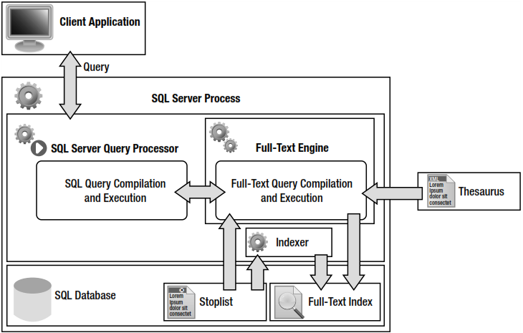

Slide 7
Implement Full Text Search
Create Full Text Catalog
Create Full Text Index
Modify Noise/Stop Word (if necessary)

Slide 8
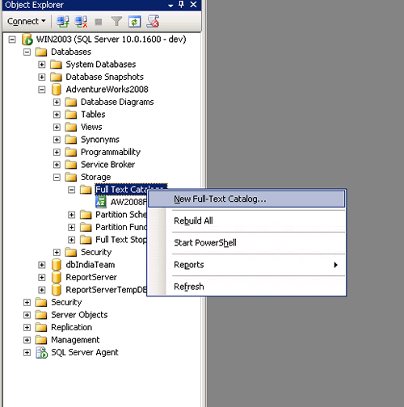
Full-Text Catalog

Slide 9
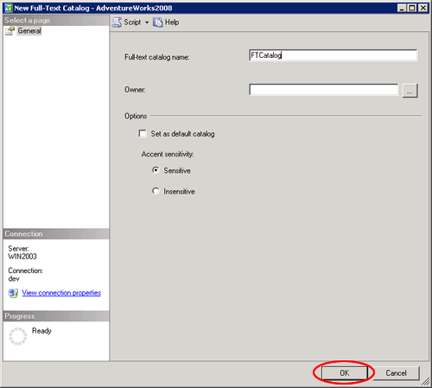
Full-Text Catalog

Slide 10
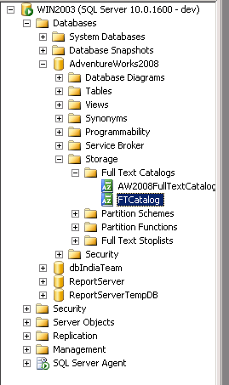
Full-Text Catalog

Slide 11
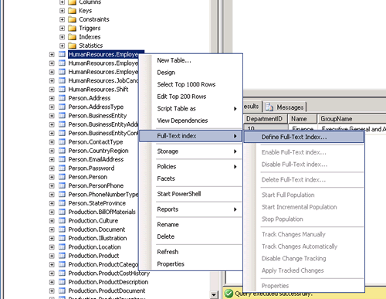
Full Text Index

Slide 12
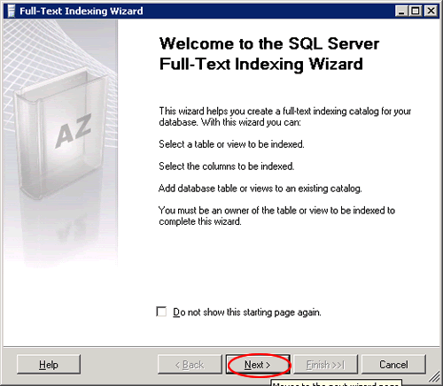
Full Text Index

Slide 13
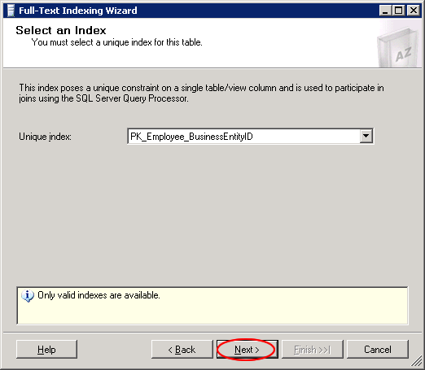
Full Text Index

Slide 14
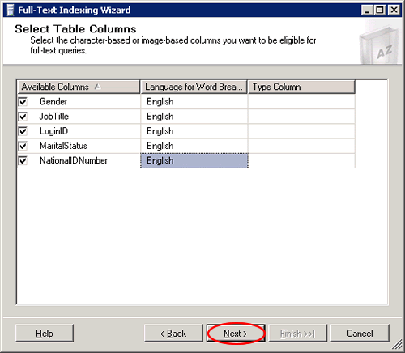
Full Text Index

Slide 15
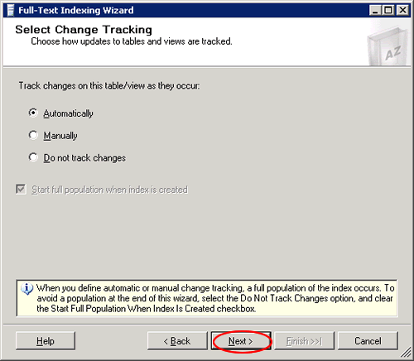
Full Text Index

Slide 16
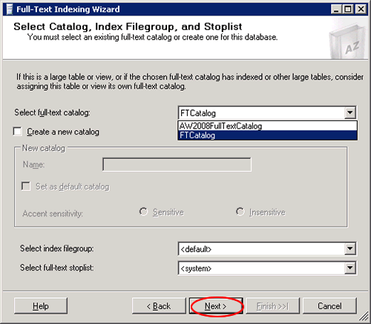
Full Text Index

Slide 17
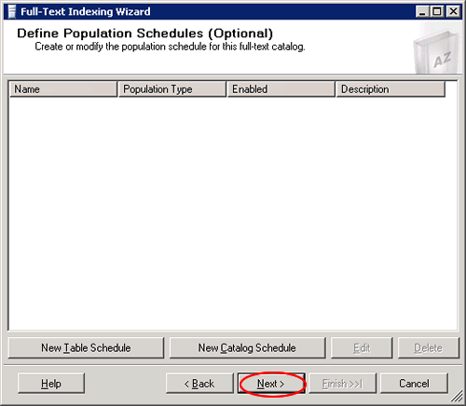
Full Text Index

Slide 18
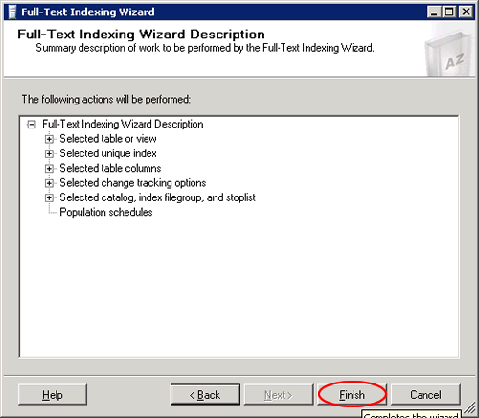
Full Text Index

Slide 19
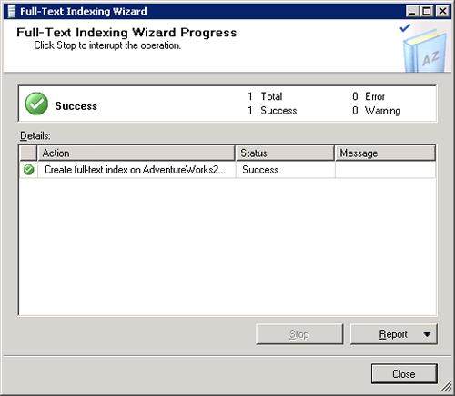
Full Text Index

Slide 20
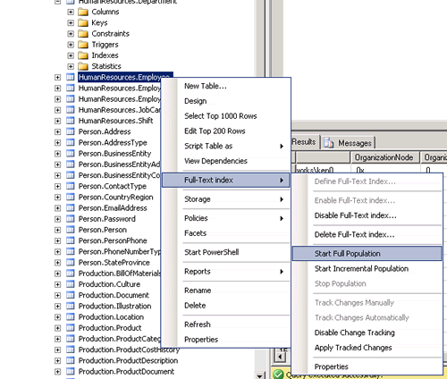
Populate the Index

Slide 21
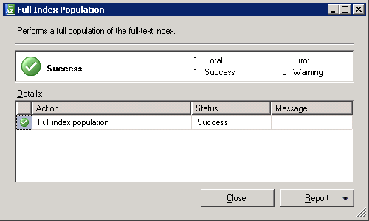
Populate the Index

